Slide 1

Association Rule Mining - III
Dr. Faisal Kamiran
DR. FAISAL KAMIRAN
INFORMATION TECHNOLOGY UNIVERSITY

Slide 2
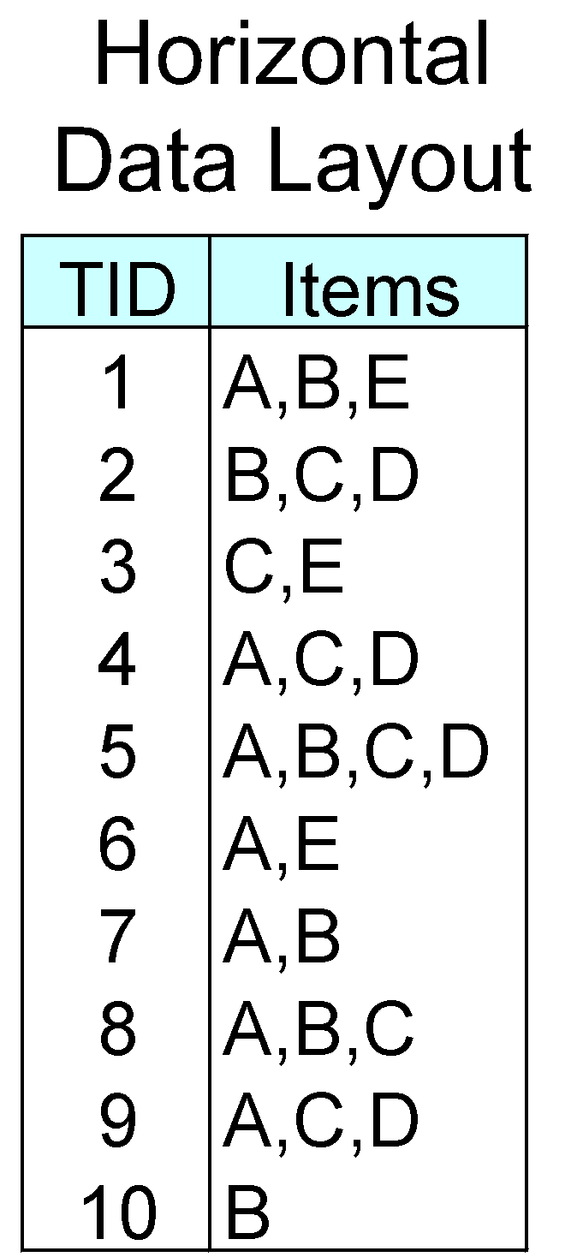
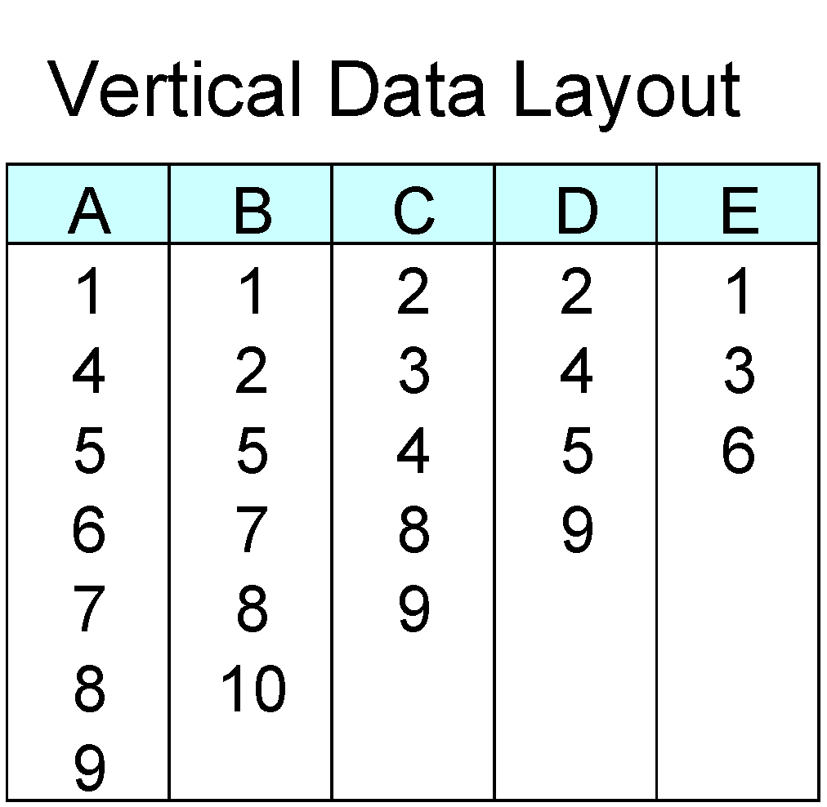
ECLAT
For each item, store a list of transaction ids (tids)
TID-list
Dr. Faisal Kamiran Information Technology University of The Punjab

Slide 3
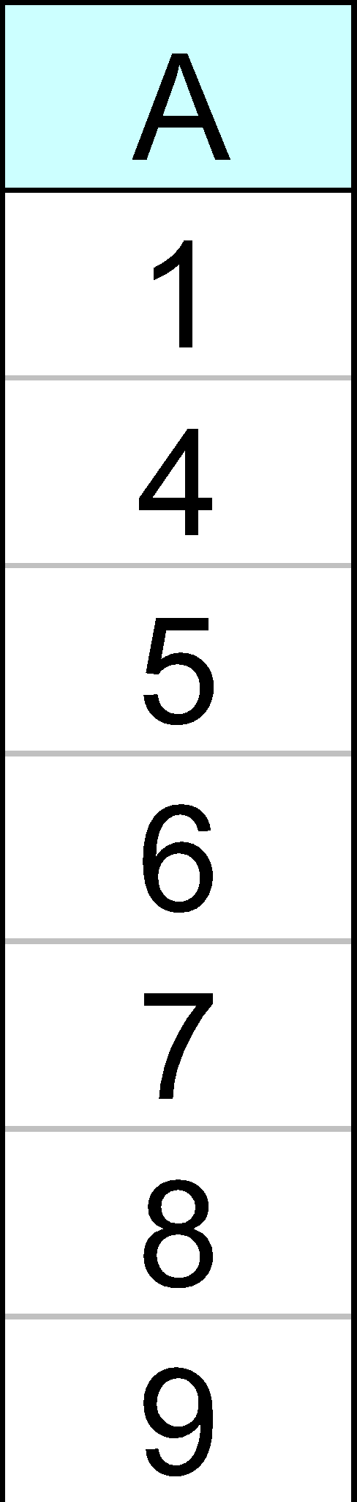
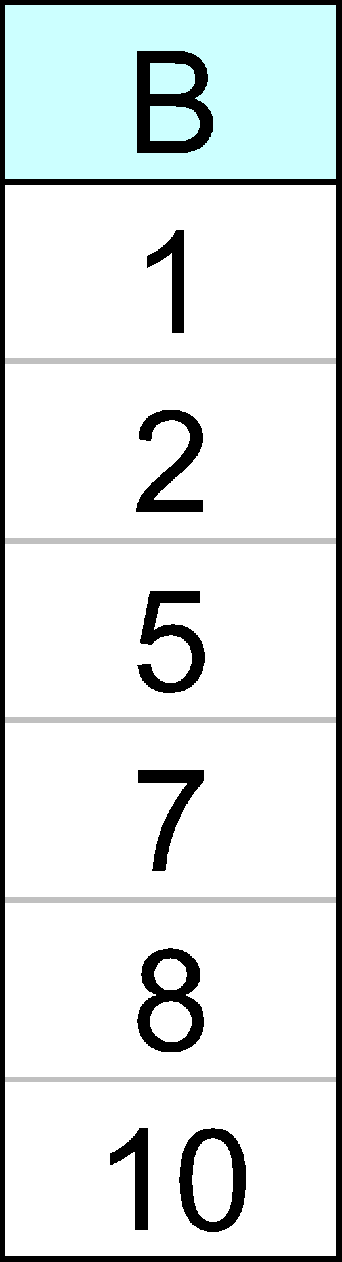
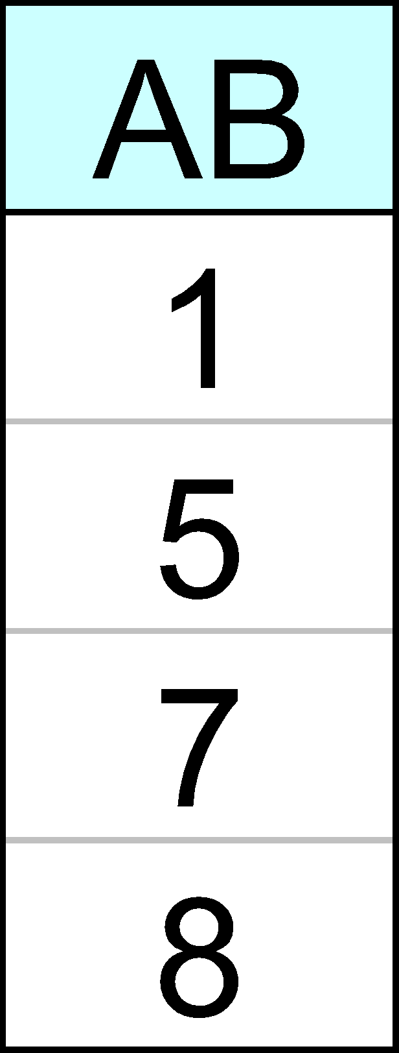
ECLAT
Determine support of any k-itemset by intersecting tid-lists of two of its (k-1) subsets.
3 traversal approaches:
top-down, bottom-up and hybrid
Advantage: very fast support counting
Disadvantage: intermediate tid-lists may become too large for memory
∧
→
Dr. Faisal Kamiran Information Technology University of The Punjab

Slide 4
Rule Generation
Given a frequent itemset L, find all non-empty subsets f ⊂ L such that f → L – f satisfies the minimum confidence requirement
If {A,B,C,D} is a frequent itemset, candidate rules:
ABC →D, ABD →C, ACD →B, BCD →A, A →BCD, B →ACD, C →ABD, D →ABC AB →CD, AC → BD, AD → BC, BC →AD, BD →AC, CD →AB,
If |L| = k, then there are 2^{k} – 2 candidate association rules (ignoring L → ∅ and ∅ → L)
Dr. Faisal Kamiran Information Technology University of The Punjab

Slide 5
Rule Generation
How to efficiently generate rules from frequent itemsets?
In general, confidence does not have an anti-monotone property
c(ABC →D) can be larger or smaller than c(AB →D)
But confidence of rules generated from the same itemset has an anti-monotone property
e.g., L = {A,B,C,D}: c(ABC → D) ≥ c(AB → CD) ≥ c(A → BCD)
Dr. Faisal Kamiran Information Technology University of The Punjab

Slide 6
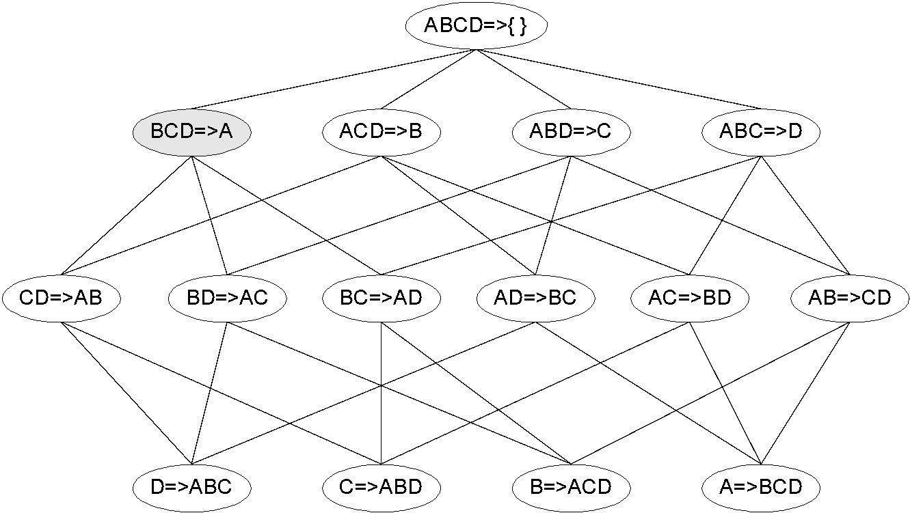
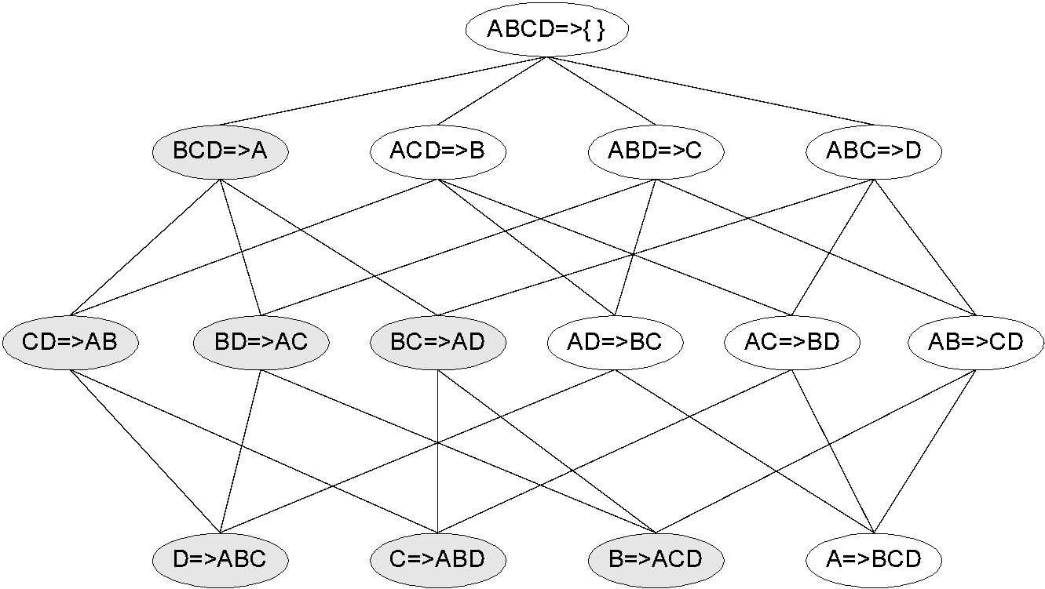
Rule Generation for Apriori Algorithm
Lattice of rules
Low Confidence Rule
Pruned Rules
Dr. Faisal Kamiran Information Technology University of The Punjab

Slide 7
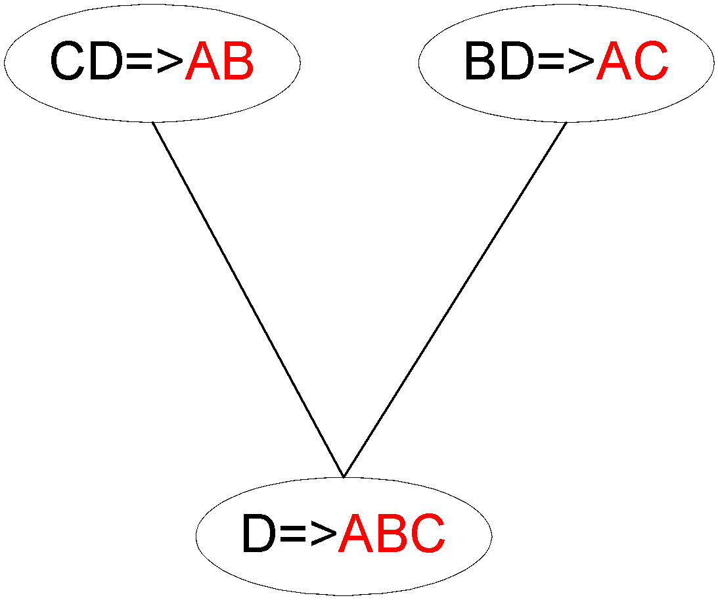
Rule Generation for Apriori Algorithm
Candidate rule is generated by merging two rules that share the same prefix in the rule consequent
join(CD=>AB,BD=>AC) would produce the candidate rule D => ABC
Prune rule D=>ABC if its subset CD=>AB does not have high confidence
Dr. Faisal Kamiran Information Technology University of The Punjab

Slide 8
Pattern Evaluation
Association rule algorithms tend to produce too many rules
many of them are uninteresting or redundant
Redundant if {A,B,C} → {D} and {A,B} → {D} have same support & confidence
Interestingness measures can be used to prune/rank the derived patterns
In the original formulation of association rules, support & confidence are the only measures used
Dr. Faisal Kamiran Information Technology University of The Punjab

Slide 9
Computing Interestingness Measure
Given a rule X → Y, information needed to compute rule interestingness can be obtained from a contingency table
Contingency table for X → Y
 | Y | Y
X | f₁₁ | f₁₀ | f₁₊
X | f₀₁ | f₀₀ | f_{o+}
 | f₊₁ | f₊₀ | |T|
f₁₁: support of X and Y f₁₀: support of X and Y f₀₁: support of X and Y f₀₀: support of X and Y
Used to define various measures
support, confidence, lift, Gini, etc.
Dr. Faisal Kamiran Information Technology University of The Punjab

Slide 10
Drawback of Confidence
 | Coffee | Coffee
Tea | 15 | 5 | 20
Tea | 75 | 5 | 80
 | 90 | 10 | 100
Association Rule: Tea → Coffee
Confidence= P(Coffee|Tea) = 0.75
but P(Coffee) = 0.9
Although confidence is high, rule is misleading
P(Coffee|Tea) = 0.9375
Dr. Faisal Kamiran Information Technology University of The Punjab

Slide 11
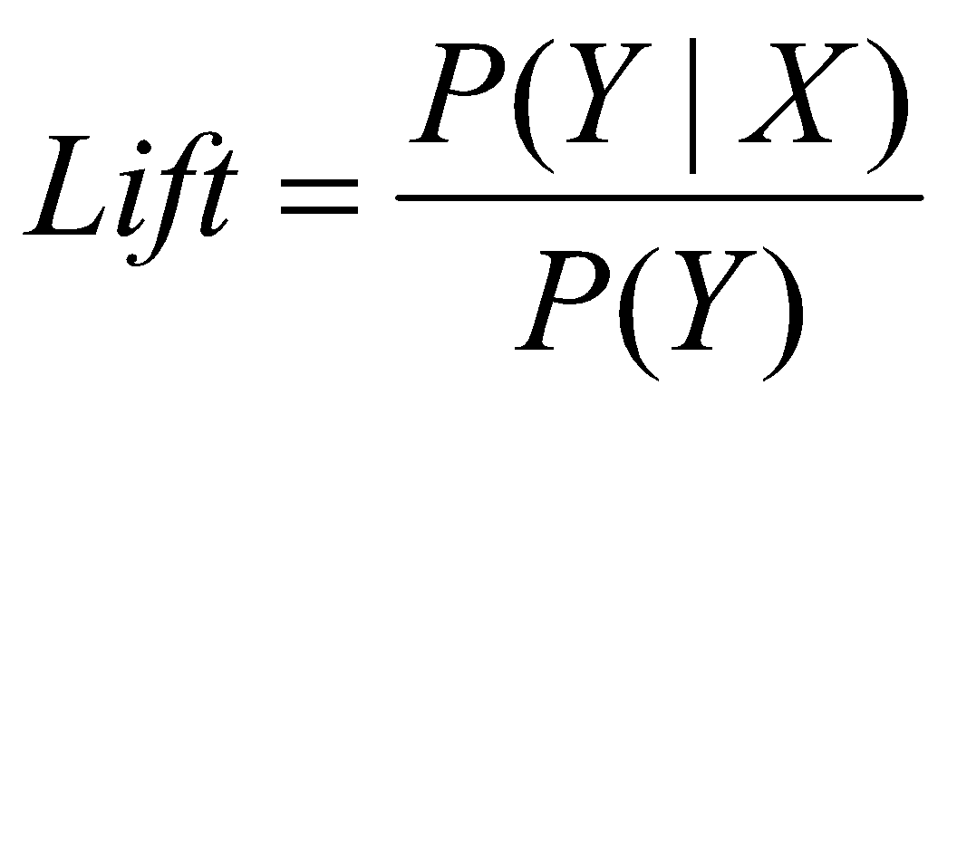
Statistical-based Measures
Measures that take into account statistical dependence
Dr. Faisal Kamiran Information Technology University of The Punjab

Slide 12
Example: Lift/Interest
 | Coffee | Coffee
Tea | 15 | 5 | 20
Tea | 75 | 5 | 80
 | 90 | 10 | 100
Association Rule: Tea → Coffee
Confidence= P(Coffee|Tea) = 0.75
but P(Coffee) = 0.9
Lift = 0.75/0.9= 0.8333 (< 1, therefore is negatively associated)
Dr. Faisal Kamiran Information Technology University of The Punjab

Slide 13
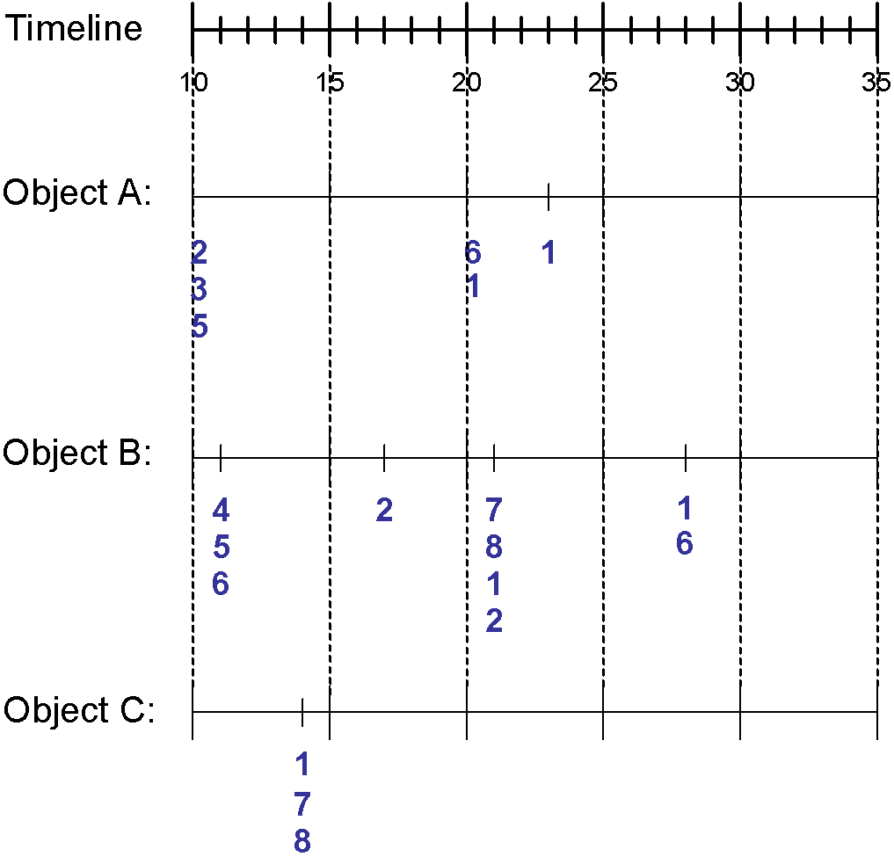
Sequence Data
Sequence Database:
Object
Timestamp
Events
A
10
2, 3, 5
A
20
6, 1
A
23
1
B
11
4, 5, 6
B
17
2
B
21
7, 8, 1, 2
B
28
1, 6
C
14
1, 8, 7
Dr. Faisal Kamiran Information Technology University of The Punjab

Slide 14
Sequence Data
Sequence Database | Sequence | Element (Transaction) | Event (Item)
Customer | Purchase history of a given customer | A set of items bought by a customer at time t | Books, diary products, CDs, etc
Web Data | Browsing activity of a particular Web visitor | A collection of files viewed by a Web visitor after a single mouse click | Home page, index page, contact info, etc
Event data | History of events generated by a given sensor | Events triggered by a sensor at time t | Types of alarms generated by sensors
Genome sequences | DNA sequence of a particular species | An element of the DNA sequence | Bases A,T,G,C
Element (Transaction)
E1 E2
E1 E3
E3 E4
Event (Item)
E2
E2
Sequence
Dr. Faisal Kamiran Information Technology University of The Punjab

Slide 15
Formal Definition of a Sequence
A sequence is an ordered list of elements (transactions)
s = < e₁ e₂ e₃ … >
Each element contains a collection of events (items)
e_{i} = {i₁, i₂, …, i_{k}}
Each element is attributed to a specific time or location
Length of a sequence, |s|, is given by the number of elements of the sequence
A k-sequence is a sequence that contains k events (items)
Dr. Faisal Kamiran Information Technology University of The Punjab

Slide 16
Examples of Sequence
Web sequence:
< {Homepage} {Electronics} {Digital Cameras} {Canon Digital Camera} {Shopping Cart} {Order Confirmation} {Return to Shopping} >
Sequence of books checked out at a library:
<{Fellowship of the Ring} {The Two Towers} {Return of the King}>
Dr. Faisal Kamiran Information Technology University of The Punjab

Slide 17
Formal Definition of a Subsequence
A sequence <a₁ a₂ … a_{n}> is contained in another sequence <b₁ b₂ … b_{m}> (m ≥ n) if there exist integers i₁ < i₂ < … < i_{n} such that a₁ ⊆ b_{i1} , a₂ ⊆ b_{i1}, …, a_{n} ⊆ b_{in}
The support of a subsequence w is defined as the fraction of data sequences that contain w
A sequential pattern is a frequent subsequence (i.e., a subsequence whose support is ≥ minsup)
Data sequence | Subsequence | Contain?
< {2,4} {3,5,6} {8} > | < {2} {3,5} > | Yes
< {1,2} {3,4} > | < {1} {2} > | No
< {2,4} {2,4} {2,5} > | < {2} {4} > | Yes
Dr. Faisal Kamiran Information Technology University of The Punjab

Slide 18
Sequential Pattern Mining: Definition
Given:
a database of sequences
a user-specified minimum support threshold, minsup
Task:
Find all subsequences with support ≥ minsup
Dr. Faisal Kamiran Information Technology University of The Punjab

Slide 19
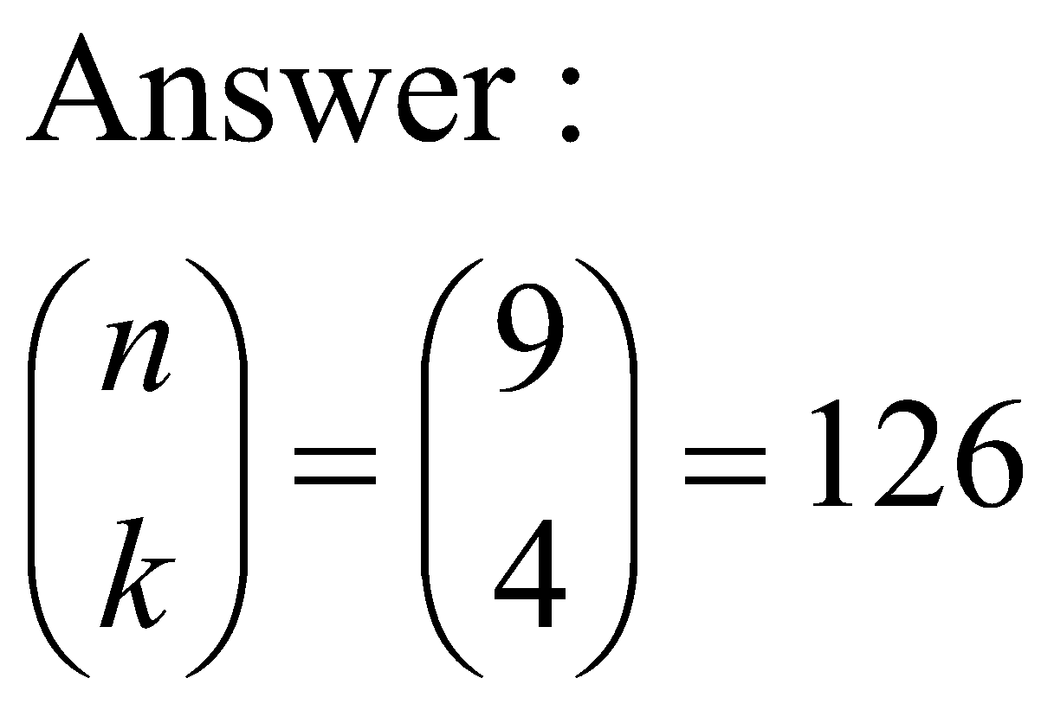
Sequential Pattern Mining: Challenge
Given a sequence: <{a b} {c d e} {f} {g h i}>
Examples of subsequences:
<{a} {c d} {f} {g} >, < {c d e} >, < {b} {g} >, etc.
How many k-subsequences can be extracted from a given n-sequence?
<{a b} {c d e} {f} {g h i}> n = 9
k=4: Y _ _ Y Y _ _ _ Y
<{a} {d e} {i}>
Dr. Faisal Kamiran Information Technology University of The Punjab

Slide 20
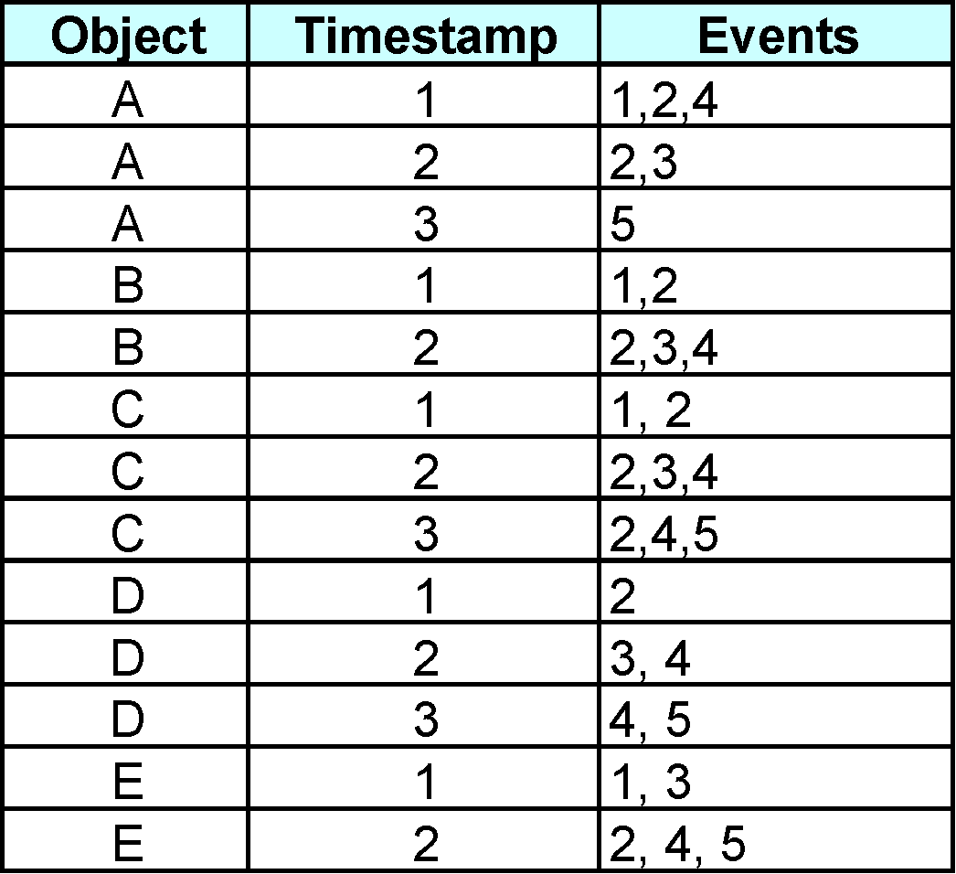
Sequential Pattern Mining: Example
Minsup = 50%
Examples of Frequent Subsequences:
< {1,2} > s=60%
< {2,3} > s=60%
< {2,4}> s=80%
< {3} {5}> s=80%
< {1} {2} > s=80%
< {2} {2} > s=60%
< {1} {2,3} > s=60%
< {2} {2,3} > s=60%
< {1,2} {2,3} > s=60%
Dr. Faisal Kamiran Information Technology University of The Punjab

Slide 21
Sequential Pattern Mining: Example
Minsup = 50%
Examples of Frequent Subsequences:
< {1,2} > s=60%
< {2,3} > s=60%
< {2,4}> s=80%
< {3} {5}> s=80%
< {1} {2} > s=80%
< {2} {2} > s=60%
< {1} {2,3} > s=60%
< {2} {2,3} > s=60%
< {1,2} {2,3} > s=60%
Dr. Faisal Kamiran Information Technology University of The Punjab

Slide 22
Sequential Pattern Mining: Example
Minsup = 50%
Examples of Frequent Subsequences:
< {1,2} > s=60%
< {2,3} > s=60%
< {2,4}> s=80%
< {3} {5}> s=80%
< {1} {2} > s=80%
< {2} {2} > s=60%
< {1} {2,3} > s=60%
< {2} {2,3} > s=60%
< {1,2} {2,3} > s=60%
Dr. Faisal Kamiran Information Technology University of The Punjab

Slide 23
Sequential Pattern Mining: Example
Minsup = 50%
Examples of Frequent Subsequences:
< {1,2} > s=60%
< {2,3} > s=60%
< {2,4}> s=80%
< {3} {5}> s=80%
< {1} {2} > s=80%
< {2} {2} > s=60%
< {1} {2,3} > s=60%
< {2} {2,3} > s=60%
< {1,2} {2,3} > s=60%
Dr. Faisal Kamiran Information Technology University of The Punjab

Slide 24
Sequential Pattern Mining: Example
Minsup = 50%
Examples of Frequent Subsequences:
< {1,2} > s=60%
< {2,3} > s=60%
< {2,4}> s=80%
< {3} {5}> s=80%
< {1} {2} > s=80%
< {2} {2} > s=60%
< {1} {2,3} > s=60%
< {2} {2,3} > s=60%
< {1,2} {2,3} > s=60%
Dr. Faisal Kamiran Information Technology University of The Punjab

Slide 25
Sequential Pattern Mining: Example
Minsup = 50%
Examples of Frequent Subsequences:
< {1,2} > s=60%
< {2,3} > s=60%
< {2,4}> s=80%
< {3} {5}> s=80%
< {1} {2} > s=80%
< {2} {2} > s=60%
< {1} {2,3} > s=60%
< {2} {2,3} > s=60%
< {1,2} {2,3} > s=60%
Dr. Faisal Kamiran Information Technology University of The Punjab

Slide 26
Sequential Pattern Mining: Example
Minsup = 50%
Examples of Frequent Subsequences:
< {1,2} > s=60%
< {2,3} > s=60%
< {2,4}> s=80%
< {3} {5}> s=80%
< {1} {2} > s=80%
< {2} {2} > s=60%
< {1} {2,3} > s=60%
< {2} {2,3} > s=60%
< {1,2} {2,3} > s=60%
Dr. Faisal Kamiran Information Technology University of The Punjab

Slide 27
Sequential Pattern Mining: Example
Minsup = 50%
Examples of Frequent Subsequences:
< {1,2} > s=60%
< {2,3} > s=60%
< {2,4}> s=80%
< {3} {5}> s=80%
< {1} {2} > s=80%
< {2} {2} > s=60%
< {1} {2,3} > s=60%
< {2} {2,3} > s=60%
< {1,2} {2,3} > s=60%
Dr. Faisal Kamiran Information Technology University of The Punjab

Slide 28
Sequential Pattern Mining: Example
Minsup = 50%
Examples of Frequent Subsequences:
< {1,2} > s=60%
< {2,3} > s=60%
< {2,4}> s=80%
< {3} {5}> s=80%
< {1} {2} > s=80%
< {2} {2} > s=60%
< {1} {2,3} > s=60%
< {2} {2,3} > s=60%
< {1,2} {2,3} > s=60%
Dr. Faisal Kamiran Information Technology University of The Punjab

Slide 29
Extracting Sequential Patterns
Given n events: i₁, i₂, i₃, …, i_{n}
Candidate 1-subsequences:
<{i₁}>, <{i₂}>, <{i₃}>, …, <{i_{n}}>
Candidate 2-subsequences:
<{i₁, i₂}>, <{i₁, i₃}>, …, <{i₁} {i₁}>, <{i₁} {i₂}>, …, <{i_{n-1}} {i_{n}}>
Candidate 3-subsequences:
<{i₁, i₂ , i₃}>, <{i₁, i₂ , i₄}>, …, <{i₁, i₂} {i₁}>, <{i₁, i₂} {i₂}>, …,
<{i₁} {i₁ , i₂}>, <{i₁} {i₁ , i₃}>, …, <{i₁} {i₁} {i₁}>, <{i₁} {i₁} {i₂}>, …
Dr. Faisal Kamiran Information Technology University of The Punjab

Slide 30
Generalized Sequential Pattern (GSP)
Step 1:
Make the first pass over the sequence database D to yield all the 1-element frequent sequences
Step 2:
Repeat until no new frequent sequences are found
Candidate Generation:
Merge pairs of frequent subsequences found in the (k-1)th pass to generate candidate sequences that contain k items
Candidate Pruning:
Prune candidate k-sequences that contain infrequent (k-1)-subsequences
Dr. Faisal Kamiran Information Technology University of The Punjab

Slide 31
Generalized Sequential Pattern (GSP)
Step 2:
Repeat until no new frequent sequences are found
Candidate Generation:
Candidate Pruning:
Support Counting:
Make a new pass over the sequence database D to find the support for these candidate sequences
Candidate Elimination:
Eliminate candidate k-sequences whose actual support is less than minsup
Dr. Faisal Kamiran Information Technology University of The Punjab

Slide 32
Candidate Generation
Base case (k=2):
Merging two frequent 1-sequences <{i₁}> and <{i₂}> will produce two candidate 2-sequences: <{i₁} {i₂}> and <{i₁ i₂}>
General case (k>2):
A frequent (k-1)-sequence w₁ is merged with another frequent (k-1)-sequence w₂ to produce a candidate k-sequence if the subsequence obtained by removing the first event in w₁ is the same as the subsequence obtained by removing the last event in w₂
The resulting candidate after merging is given by the sequence w₁ extended with the last event of w₂.
If the last two events in w₂ belong to the same element, then the last event in w₂ becomes part of the last element in w₁
Otherwise, the last event in w₂ becomes a separate element appended to the end of w₁
Dr. Faisal Kamiran Information Technology University of The Punjab

Slide 33
Candidate Generation Examples
Merging the sequences w₁=<{1} {2 3} {4}> and w₂ =<{2 3} {4 5}> will produce the candidate sequence < {1} {2 3} {4 5}> because the last two events in w₂ (4 and 5) belong to the same element
Merging the sequences w₁=<{1} {2 3} {4}> and w₂ =<{2 3} {4} {5}> will produce the candidate sequence < {1} {2 3} {4} {5}> because the last two events in w₂ (4 and 5) do not belong to the same element
We do not have to merge the sequences w₁ =<{1} {2 } {3}> and w₂ =<{1} {2,5}>
Dr. Faisal Kamiran Information Technology University of The Punjab

Slide 34
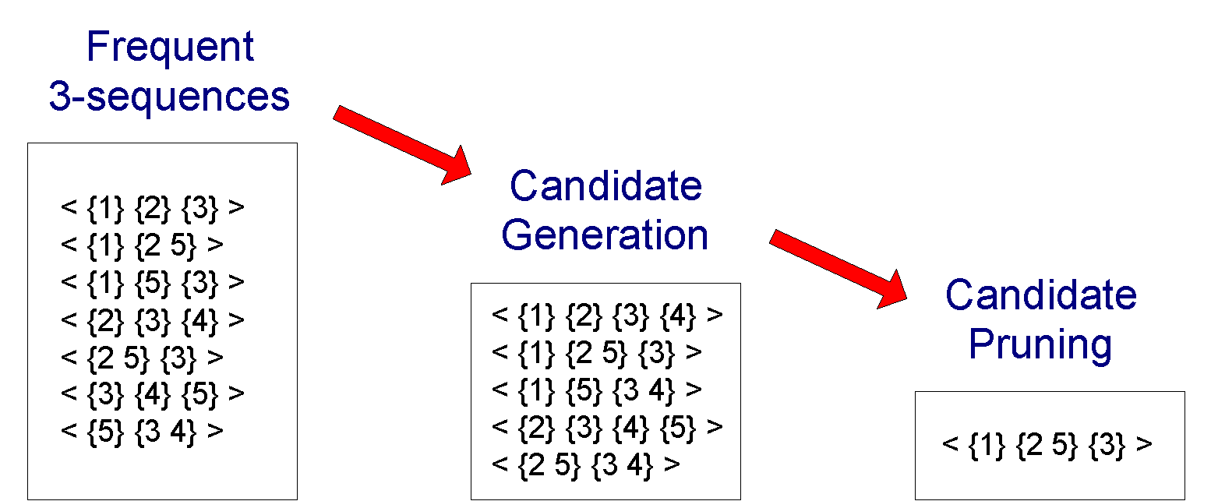
GSP Example
Dr. Faisal Kamiran Information Technology University of The Punjab

Slide 35
Timing Constraints (I)
{A B} {C} {D E}
x_{g}: max-gap
n_{g}: min-gap
<= x_{g}
>n_{g}
<= m_{s}
x_{g} = 2, n_{g} = 0
Data sequence | Subsequence | Contain?
< {2,4} {3,5,6} {4,7} {4,5} {8} > | < {6} {5} > | Yes
< {1} {2} {3} {4} {5}> | < {1} {4} > | No
< {1} {2,3} {3,4} {4,5}> | < {2} {3} {5} > | Yes
< {1,2} {3} {2,3} {3,4} {2,4} {4,5}> | < {1,2} {5} > | No
Dr. Faisal Kamiran Information Technology University of The Punjab

Slide 36
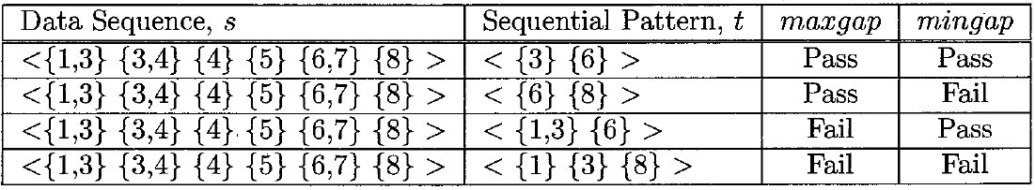
Timing Constraints (I)
Maxgap = 3
Mingap = 1
Dr. Faisal Kamiran Information Technology University of The Punjab

Slide 37
Timing Constraints (I)
Maxgap = 3
Mingap = 1
Dr. Faisal Kamiran Information Technology University of The Punjab

Slide 38
Mining Sequential Patterns with Timing Constraints
Approach 1:
Mine sequential patterns without timing constraints
Postprocess the discovered patterns
Approach 2:
Modify GSP to directly prune candidates that violate timing constraints
Question:
Does Apriori principle still hold?
Dr. Faisal Kamiran Information Technology University of The Punjab

Slide 39
Apriori Principle for Sequence Data
Suppose:
x_{g} = 1 (max-gap)
n_{g} = 0 (min-gap)
minsup = 60%
<{2} {5}> support = 40%
but
<{2} {3} {5}> support = 60%
Problem exists because of max-gap constraint
No such problem if max-gap is infinite
Dr. Faisal Kamiran Information Technology University of The Punjab

